Slide 1
CS 3006 Parallel and Distributed Computing Lecture 10
Danyal Farhat
FAST School of Computing
NUCES Lahore

Slide 2
Lecture 10 Shared Memory Programming with OpenMP – Part 2

Slide 3
Outline
Review of OpenMP Library Functions
#pragma omp directive [clause list]
Difference between omp for and omp parallel
Some Useful Clauses in OpenMP
private
firstprivate
lastprivate
Reduction Clause
Conditional Parallelism Clause

Slide 4
Outline (Cont.)
Scheduling Loops
Static: schedule(static, [chunk-size])
Dynamic: schedule(dynamic, [chunk-size])
Guided: schedule(guided, C):
No Wait Clause
Functional/Task Parallelism
omp sections pragma
Home Task
Summary
Additional Resources

Slide 5
Review of OpenMP Library Functions
Controlling Number of Threads and Processors
void omp_set_num_threads (int num_threads);
int omp_get_num_threads ( );
int omp_get_max_threads ( );
int omp_get_thread_num ( );
int omp_get_num_procs ( );
int omp_in_parallel ( );
Controlling and Monitoring Thread Creation
void omp_set_dynamic (int dynamic_threads);
int omp_get_dynamic ( );
void omp_set_nested (int nested);
int omp_get_nested ();

Slide 6
#pragma omp directive [clause list]
#pragma omp parallel
to create concurrent threads
#pragma omp for
split parallel iteration space across threads
#pragma omp sections
when different independent tasks need to be executed on different threads
Note: if no parallel directive, then for and sections directives would work serially

Slide 7
Difference between omp for and omp parallel
#pragma omp parallel
{
#pragma omp for
for (i = 0 < i < n; i++) {
//omp for schedules/distributes iterations between the threads
/* body of parallel for loop */
}
}
is same as
#pragma omp parallel for
for (i = 0 < i < n; i++) {
/* body of parallel for loop */
}

Slide 8
Some Useful Clauses in OpenMP
A clause is an optional, additional component to a pragma
Private: The private clause directs the compiler to make one or more variables private
int k=3;
#pragma omp parallel for default(shared) private(j) shared(k)
for (i = 0; i < n; i++)
for (j = 0; j < n; j++)
a[i][j] = MIN(a[i][j],a[i][k]+tmp);
Comments:
Here the private variable j is undefined -
when this parallel construct is entered
when this parallel construct is exited
Notes:
GNU is an operating system.

Slide 9
Some Useful Clauses in OpenMP (Cont.)
firstprivate: It directs the compiler to create private variables having initial values identical to the value of the variable controlled by the master thread as the loop is entered
s = complex_function();
#pragma omp parallel for firstprivate(s) num_threads(2)
for (i = 0 ; i < n ; i ++) (
s = s*omp_get_thread_num();
printf(“S is %d at thread#%d\n”, s,omp_get_thread_num());
}
Notes:
GNU is an operating system.

Slide 10
Some Useful Clauses in OpenMP (Cont.)
lastprivate: used to copy back to the master thread’s copy of the variable, the private copy of the variable from the thread that executed the last iteration
s = complex_function();
#pragma omp parallel for private(j) firstprivate(s) lastprivate(s)
for (i = 0 ; i < n ; i ++) (
s +=1;
}
printf(“s after join:%d\n”,s);//value of s as it was for last iteration of the loop
Notes:
GNU is an operating system.

Slide 11
Reduction Clause
OpenMP provides support for Reductions
May add reduction clause to parallel for pragma
Specify reduction operation and reduction variable
OpenMP takes care of storing partial results in private variables and combining partial results after the loop

Slide 12
Reduction Clause (Cont.)
The reduction clause has this syntax: reduction (<op> :<variable>)
Operators
+ Sum
* Product
& Bitwise and
| Bitwise or
^ Bitwise exclusive or
&& Logical and
|| Logical or

Slide 13
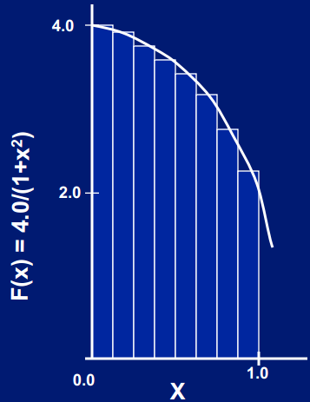
Reduction Clause (Cont.)
double area, pi, x;
int i, n;
...
area = 0.0;
#pragma omp parallel for private(x) reduction(+:area)
for (i = 0; i < n; i++) {
x = (i+0.5)/n;
area += 4.0/(1.0 + x*x);
}
pi = area / n;

Slide 14
Conditional Parallelism Clause
if Clause: The if clause gives us the ability to direct the compiler to insert code that determines at run-time whether the loop should be executed in parallel or not
The clause has this syntax: if (<scalar expression> )
double area, pi, x;
int i, n;
...
area = 0.0;
#pragma omp parallel for private(x) reduction(+:area) if(n>5000)
for (i = 0; i < n; i++) {
x = (i+0.5)/n;
area += 4.0/(1.0 + x*x);
}
pi = area / n;

Slide 15
Scheduling Loops (a clause)
Scheduling the loops means dividing number of iterations between the processes
Syntax of schedule clause
schedule (<type>[,<chunk> ])
Schedule type is required but, chunk size optional
A chunk is a contiguous range of iterations
Increasing chunk size reduces scheduling overhead and may increase cache hit rate [due to operations on contiguous memory locations]
Decreasing chunk size allows finer balancing of workloads

Slide 16
Scheduling Loops
Static: schedule(static, [chunk-size])
Splits the iteration space into equal chunks of size chunk-size and assigns them to threads in a round-robin fashion
When no chunk-size is specified, the iteration space is split into as many chunks as there are threads (i.e., size of each is n/tot.threads) and one chunk is assigned to each thread
Decision about work division is done before executing the code
Results in lower scheduling overhead. But, can cause load-imbalance if all processors are not of same compute-capability
#pragma omp for schedule(static, chunk_size)
#pragma omp for schedule(static)

Slide 17
Scheduling Loops (Cont.)
Static: schedule(static[, chunk-size])
Example when reducing chunk size improves load-balancing
#pragma omp parallel for private (j) schedule(static, 1)
for (i = 0; i < n; i++)
for ( j = i; j < n; j++)
a[i][j] = complex_func(i,j);

Slide 18
Scheduling Loops (Cont.)
Dynamic: schedule(dynamic, [chunk-size])
The iteration space is partitioned into chunks given by chunk-size
Initially every thread is assigned single chunk
The decision for remaining iteration chunks is done on run-time
This means chunk is assigned to threads as they become idle
This takes care of the temporal imbalances resulting from static scheduling
If no chunk-size is specified, it defaults to a single iteration per chunk
#pragma omp for schedule(dynamic, chunk_size)
#pragma omp for schedule(dynamic)

Slide 19
Scheduling Loops (Cont.)
Guided:
schedule(guided, C):
Dynamic allocation of chunks to tasks using guided self-scheduling heuristic
Initial chunks are bigger, later chunks are smaller, minimum chunk size is C
schedule(guided):
Guided self-scheduling with minimum chunk size 1
schedule(runtime):
schedule chosen at run-time based on value of OMP_SCHEDULE env. variable

Slide 20
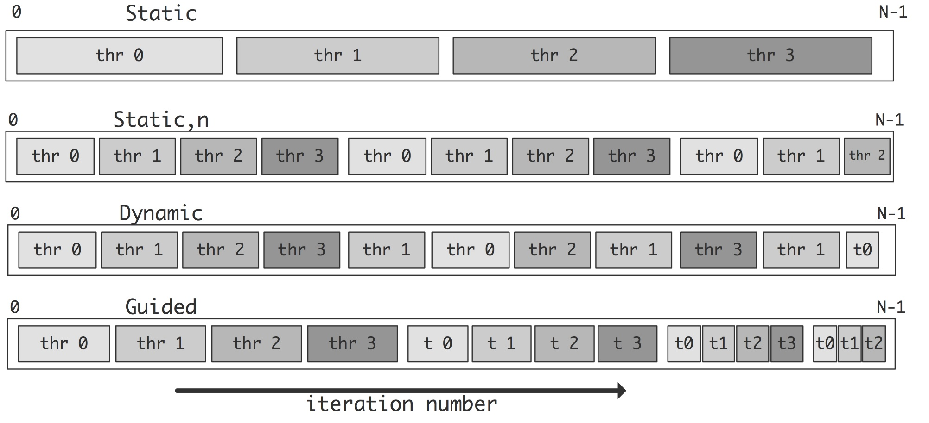
Scheduling Loops(Summary)

Slide 21
No Wait Clause
In order to avoid implicit barrier
A thread can easily move to next after completed its assign task/iterations
#pragma omp parallel for nowait

Slide 22
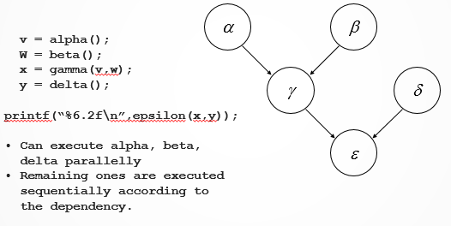
Functional/Task Parallelism
If your code is based on different segments or sections that can be executed in parallel
Also known to as task parallelism

Slide 23
Parallel sections, section pragmas
#pragma omp parallel sections
{
#pragma omp section //[optional for 1st block]
v = alpha();
#pragma omp section
W = beta();
#pragma omp section
y = delta();
}
x = gamma(v,w);
printf(“%6.2f\n”, epsilon(x,y));
#pragma omp parallel sections creates a team of threads which executes the sections in the region in parallel
Sections that can be executed parallel are preceded by ‘omp section’ pragma

Slide 24
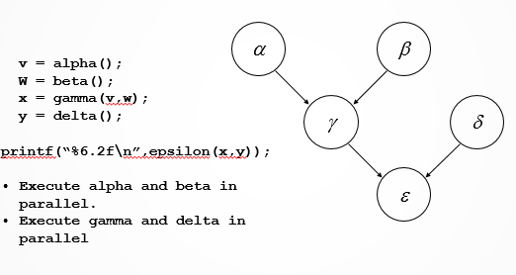
Functional Parallelism – Another Approach

Slide 25
sections pragma
#pragma omp parallel num_threds(2)
{
#pragma omp sections
{
#pragma omp section //optional
v = alpha();
#pragma omp section
w = beta();
} // here an implicit barrier exists
#pragma omp sections
{
x = gamma(v, w);
#pragma omp section
y = delta();
}
}
printf ("%6.2f\n", epsilon(x,y));

Slide 26
omp sections pragma
Appears inside a parallel block of code
This pragma distributes enclosed sections among the threads in the team
The difference between omp parallel sections and omp sections is that:
Omp parallel sections generate its own team of threads
While simple omp sections pragma uses existing team of threads and distributes section among the threads
If multiple sections pragmas are inside one parallel block, may reduce fork/join costs

Slide 27
Home Task
Calculate the value of pi using reduction operation having parallel execution if and only if number of rectangles (sub-areas) under the curve are greater than 10,000.

Slide 28
Summary
Review of OpenMP Library Functions
Controlling Number of Threads and Processors
Controlling and Monitoring Thread Creation
#pragma omp directive [clause list]
#pragma omp parallel - to create concurrent threads
#pragma omp for - split parallel iteration space across threads
#pragma omp sections - when different independent tasks need to be executed on different threads
Difference between omp for and omp parallel

Slide 29
Summary (Cont.)
Some Useful Clauses in OpenMP
private: Directs compiler to make one or more variables private
firstprivate: Directs compiler to create private variables having initial values identical to the value of the variable controlled by the master thread
lastprivate: Used to copy back to the master thread’s copy of the variable
Reduction Clause
OpenMP provides support for Reductions
OpenMP takes care of storing partial results in private variables and combining partial results after the loop

Slide 30
Summary (Cont.)
Conditional Parallelism Clause
The "if clause" gives the ability to direct the compiler to insert code that determines at run-time whether loop should be executed in parallel or not
Scheduling Loops
Static: schedule(static, [chunk-size])
Dynamic: schedule(dynamic, [chunk-size])
Guided: schedule(guided, C):
No Wait Clause - Used to avoid implicit barrier

Slide 31
Summary (Cont.)
Functional/Task Parallelism
Used if code is based on different segments or sections that can be executed in parallel
omp sections pragma
Omp parallel sections generate its own team of threads
While simple omp sections pragma uses existing team of threads and distributes section among the threads
Home Task

Slide 32
Additional Resources
Book: Introduction to Parallel Computing by Ananth Grama and Anshul Gupta
Chapter 7: Programming Shared Address Space Platforms
Introduction to OpenMP by Tim Mattson (Intel)
https://www.youtube.com/watch?v=nE-xN4Bf8XI&list=PLLX-Q6B8xqZ8n8bwjGdzBJ25X2utwnoEG&index=1

Slide 33
Questions?

